Slide 1


Rahul Arya
10-12-2024

Slide 2

Outline
Executive Summary
Introduction
Methodology
Results
Conclusion
Appendix

Slide 3
Executive Summary
Methodology Overview
To address the business problem, I employed the following methods:
Data Collection:
Web Scraping: Extracted historical SpaceX launch data from Wikipedia.
API Calls: Gathered detailed, structured data from SpaceX’s REST API.
Exploratory Data Analysis (EDA):
Used Python libraries (pandas, matplotlib, seaborn) to clean, visualize, and explore data for meaningful patterns.

Slide 4
Executive Summary
3. Interactive Analysis:
Developed an interactive dashboard with Plotly Dash to analyze launch data.
Created geographic visualizations with Folium to study launch site proximity.
4. Predictive Modeling:
Applied machine learning models (SVM, Decision Trees, Logistic Regression) to predict landing success.
Performed hyperparameter tuning to find the best model for accurate predictions.

Slide 5
Executive Summary
Key Result
The final model accurately predicts the success of Falcon 9 first-stage landings, providing valuable insights for cost reduction and competitive bidding.

Slide 6
Introduction
Background
SpaceX has revolutionized the space industry by making rocket launches more affordable through reusable rocket technology.
The Falcon 9 rocket’s first stage is designed to land and be reused, significantly reducing launch costs from $165 million to $62 million.
Business Problem
Predicting the success of Falcon 9 first-stage landings is critical to evaluating cost efficiency.
Competitors can use this prediction model to make informed decisions when bidding against SpaceX for launch contracts.

Slide 7
Introduction
Objective
Develop a predictive model to determine if the Falcon 9 first stage will successfully land, leveraging historical and technical data.
Provide insights into the factors influencing landing success to aid decision-making and improve cost optimization strategies.

Slide 8

Section 1

Slide 9
Methodology
Executive Summary
Data collection methodology:
Web Scraping: Used BeautifulSoup to extract historical launch data from Wikipedia, focusing on key parameters like time & dates, booster versions, and outcomes.
API Calls: Accessed SpaceX's REST API to retrieve detailed and real-time information, such as rocket specifications, payload details, and launchpad coordinates.

Slide 10
Methodology
Executive Summary
Perform data wrangling:
Handled missing and inconsistent values in the dataset.
Standardized data formats for easier analysis (e.g., date).
Created a 'class' column to label outcomes, categorizing them based on success or failure for better analysis and modeling.

Slide 11
Methodology
Executive Summary
Perform exploratory data analysis (EDA) using visualization and SQL
Conducted using Python libraries like pandas, matplotlib, and seaborn.
Visualized key trends and patterns, such as:Payload mass vs. landing success.
Success rates by launch site and orbit type.
Leveraged SQL queries for in-depth data exploration and filtering.

Slide 12
Methodology
Executive Summary
Perform interactive visual analytics using Folium and Plotly Dash:
Built a Plotly Dash dashboard to analyze launch records interactively, including pie charts and scatter plots.
Created maps using Folium to study launch site proximity and surrounding infrastructure.

Slide 13
Methodology
Executive Summary
Perform predictive analysis using classification models:
Employed machine learning models:
Logistic Regression, Decision Trees, and SVM.
Optimized model performance through hyperparameter tuning.
Evaluated model success with metrics like accuracy, precision, and recall.

Slide 14
Data Collection
1. Web Scraping:
Source: Wikipedia’s SpaceX launch page.
Tools Used:
BeautifulSoup: For parsing HTML and extracting relevant data from tables.
Requests: To fetch the webpage content.
Data Extracted:Launch dates, payload mass, booster version, landing status, and mission details.

Slide 15
Data Collection
2. API Calls:
Source: SpaceX’s REST API.
Tools Used:
Requests: To interact with the API and fetch JSON data.
Pandas: To convert JSON into structured DataFrames for analysis.
Data Extracted:Rocket and booster details, payload data, launchpad coordinates, and core details.

Slide 16
Data Collection – SpaceX API
source
SpaceX’s REST API
Tools Used
Pandas
Requests
Data Extracted
Rocket and booster details,
payload data,
launchpad coordinates,
and core details
GitHub URL of the completed SpaceX API calls notebook (must include completed code cell and outcome cell), as an external reference and peer-review purpose

Slide 17
Data Collection - Scraping
source
Wikipedia’s SpaceX launch page
Tools Used
BeautifulSoup
Requests
Data Extracted
Launch time & dates,
payload,
booster version,
landing status,
and mission details
the GitHub URL of the completed web scraping notebook, as an external reference and peer-review purpose

Slide 18
Data Wrangling
Handling Missing Data
Landing Pad: Returned None for missions without landing pads. This is expected and does not require further handling.
Payload Mass: Replaced missing values with the mean of the column for consistent analysis.
LandingPad
Missing value = 26
Landing pad
Replaced missing value with mean

Slide 19
Data Wrangling
Feature Engineering
Created a class column to label outcomes:
1: Successful landing. ; 0: Unsuccessful landing.
True ASDS
True RTLS
True Ocean
None ASDS
False RTLS
None None
False ASDS
False Ocean
Successful landing (class = 1)
Unsuccessful landing (class = 0)
Outcome

Slide 20
Data Wrangling
date_utc
e.g., 2006-03-24T22:30:00.000Z
datetime pandas data type
e.g.,2006-03-24
Data Formatting
Standardized date and time formats.
Add the GitHub URL of your completed data wrangling related notebooks, as an external reference and peer-review purpose

Slide 21
EDA with Data Visualization
Flight Number vs. Launch Site (Scatter Plot)
Purpose: To analyze the consistency and frequency of launches at different sites.
Payload Mass and Launch Site (Scatter Plot)
Purpose: To explore payload capacities handled by specific sites.
Success Rate by Orbit Type (Bar Chart)
Purpose: To identify which orbit types achieve higher success rates.

Slide 22
EDA with Data Visualization
Flight Number vs. Orbit Type (Scatter Plot)
Purpose: To observe the variety of orbit types as the number of missions increases.
Payload Mass vs. Orbit Type (Scatter Plot)
Purpose: To investigate compatibility between payload masses and orbit types.
Yearly Launch Success Trend (Line Chart)
Purpose: To visualize improvements in launch success rates over time.
Add the GitHub URL of your completed EDA with data visualization notebook, as an external reference and peer-review purpose

Slide 23
EDA with SQL
Unique Launch Sites: Identified all distinct launch sites used by SpaceX.
Filtered Launch Sites: Retrieved records where launch sites begin with "CCA".
Payload Analysis: Calculated total payload mass for NASA CRS missions and average payload mass for booster version F9 v1.1.
Landing Success Dates: Found the date of the first successful ground pad landing.
Drone Ship Landings: Listed boosters successful on drone ships with payloads between 4000 and 6000 kg.

Slide 24
EDA with SQL
Mission Outcomes: Counted successful and failed mission outcomes.
Maximum Payload Carriers: Identified boosters carrying the maximum payload mass using subqueries.
Year-Specific Failures: Filtered records by landing outcomes, booster versions, and launch sites for failures in 2015.
Add the GitHub URL of your completed EDA with SQL notebook, as an external reference and peer-review purpose

Slide 25
Build an Interactive Map with Folium
Launch Sites Visualization: Displayed all SpaceX launch sites as markers with circles and pop-ups for identification.
Class Markers: Added markers for each launch event, colored based on success (green) or failure (red).
Proximity Analysis: Calculated distances from launch sites to nearby infrastructure (e.g., coastlines, railways, highways, and cities) and visualized them with markers and lines.
Mouse Position Plugin: Enabled live display of latitude and longitude when hovering over the map.

Slide 26
Build an Interactive Map with Folium
Purpose :
To analyze launch site locations, assess proximity to critical infrastructure, and visualize mission outcomes interactively.
nbviewer GitHub URL : Jupyter Notebook Viewer Note: Ctrl + Click to open link

Slide 27
Build a Dashboard with Plotly Dash
Key Features :
Launch Site Dropdown: Allows users to filter data by specific launch sites or view all sites.
Payload Range Slider: Enables selection of payload mass ranges to customize the analysis.
Success Pie Chart: Visualizes the success rate of launches for selected sites.
Scatter Plot: Shows the relationship between payload mass and launch outcomes, categorized by booster versions.

Slide 28
Build a Dashboard with Plotly Dash
Purpose :
The dashboard enables interactive analysis of launch data, making it easy to identify trends, success rates, and performance based on payload and launch site.
Add the GitHub URL of your completed Plotly Dash lab, as an external reference and peer-review purpose

Slide 29
Predictive Analysis (Classification)
Overview
Built a machine learning pipeline to predict whether the Falcon 9 first stage will land successfully, utilizing Logistic Regression, SVM, Decision Trees, and KNN.
Objective: Predict landing success to reduce launch costs.
Steps
Data Preparation: Standardized data, created a class column, split into training and test data.
Model Training: Tuned hyperparameters using GridSearchCV for optimal performance.

Slide 30
Predictive Analysis (Classification)
Results:
Best Model: Decision Tree Classifier with accuracy 0.9444 on the test data. (see appendix A for features)
All models showed 0.8333 accuracy, but Decision Tree performed best with tuned hyperparameters.
Add the GitHub URL of your completed predictive analysis lab, as an external reference and peer-review purpose

Slide 31
Predictive Analysis (Classification)
Prepare data
Standardized data
Train model
Models: Logistic Regression, SVM, Decision Trees, KNN
Evaluate model
Assess models using accuracy and confusion matrix on the test set
Best model
Decision Tree showed the best performance, achieving 0.9444 accuracy on test data.
Create a class column
split into training and test data
Hyperpara. Tuning: GridSearchCV

Slide 32
Results
Success rate of landing successfully : 66.66%
SQL Analysis:
Identified key launch sites and summarized payload statistics.
Most missions were successful, with 38 successful landings and 99 successful mission outcomes overall.
High payload mass was associated with NASA CRS missions and certain booster versions.
Pandas and Matplotlib Analysis:
Success rates increased over time, with steady improvement from 2013 to 2020.

Slide 33
Results
Heavy payloads were more successful in Polar, LEO, and ISS orbits, while GTO showed mixed outcomes.
Success ratio improved with flight numbers, particularly at CCAFS SLC-40 and KSC LC-39A.
Predictive analysis results:
Best Model: Decision Tree Classifier with accuracy 0.9444 on the test data. (see appendix A for features)
All models showed 0.8333 accuracy, but Decision Tree performed best with tuned hyperparameters.

Slide 34
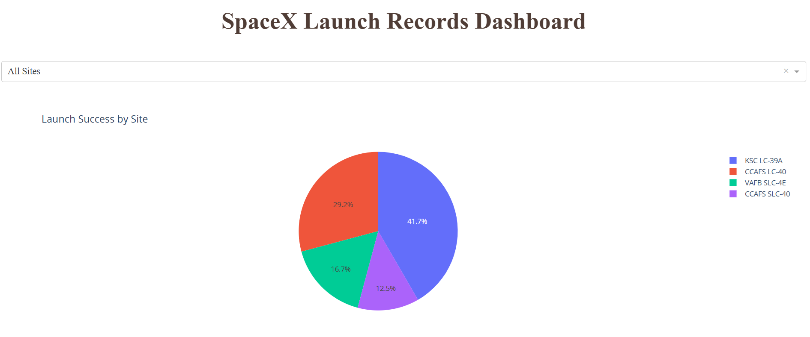
Results Interactive analytics demo in screenshots

Slide 35
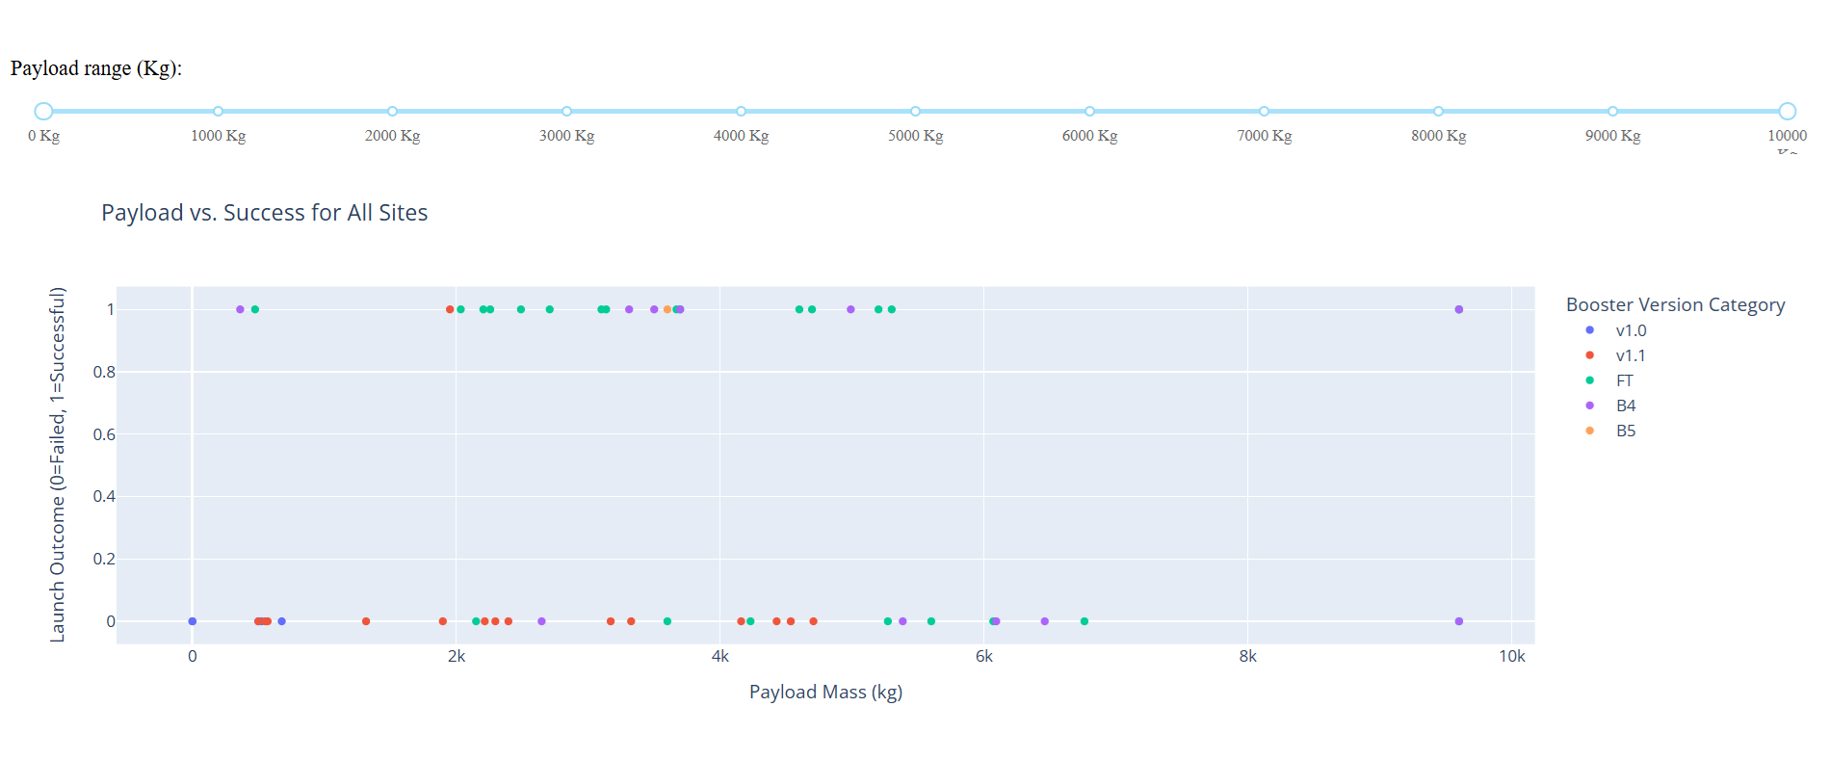
Results Interactive analytics demo in screenshots

Slide 36

Section 2

Slide 37
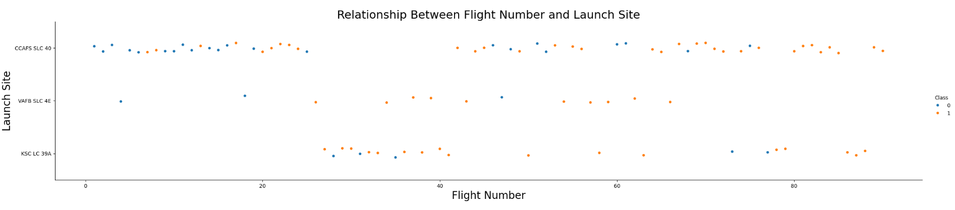
Flight Number vs. Launch Site
As the number of flights increases, the success rate at each launch site also improves.

Slide 38
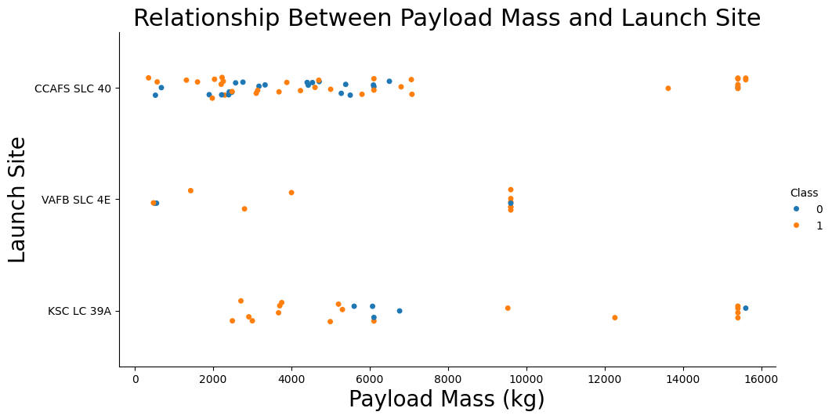
Payload vs. Launch Site

Slide 39
Payload vs. Launch Site
VAFB SLC-4E launched no heavy payloads (>10,000 kg), while success rates increase for heavy payloads at CCAFS SLC-40 and KSC LC-39A.

Slide 40
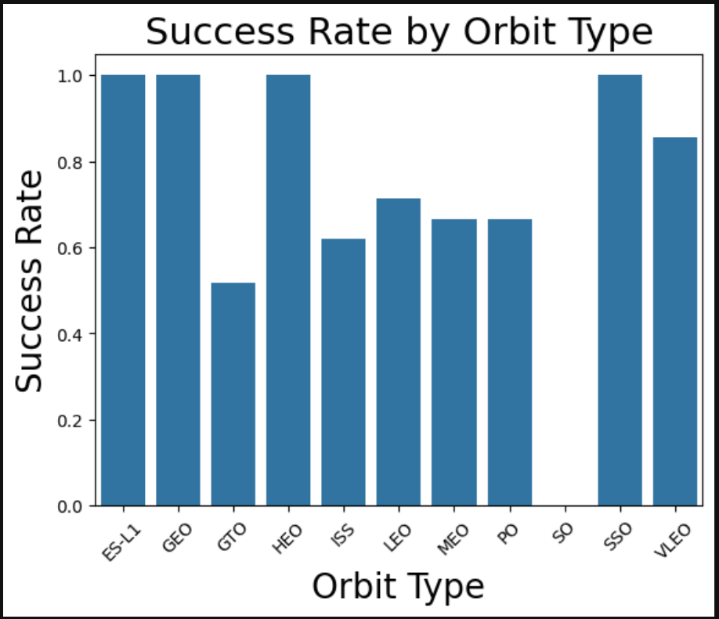
Success Rate vs. Orbit Type
High success rates for ES-L1, GEO, HEO, and SSO, though these orbits are rare.

Slide 41
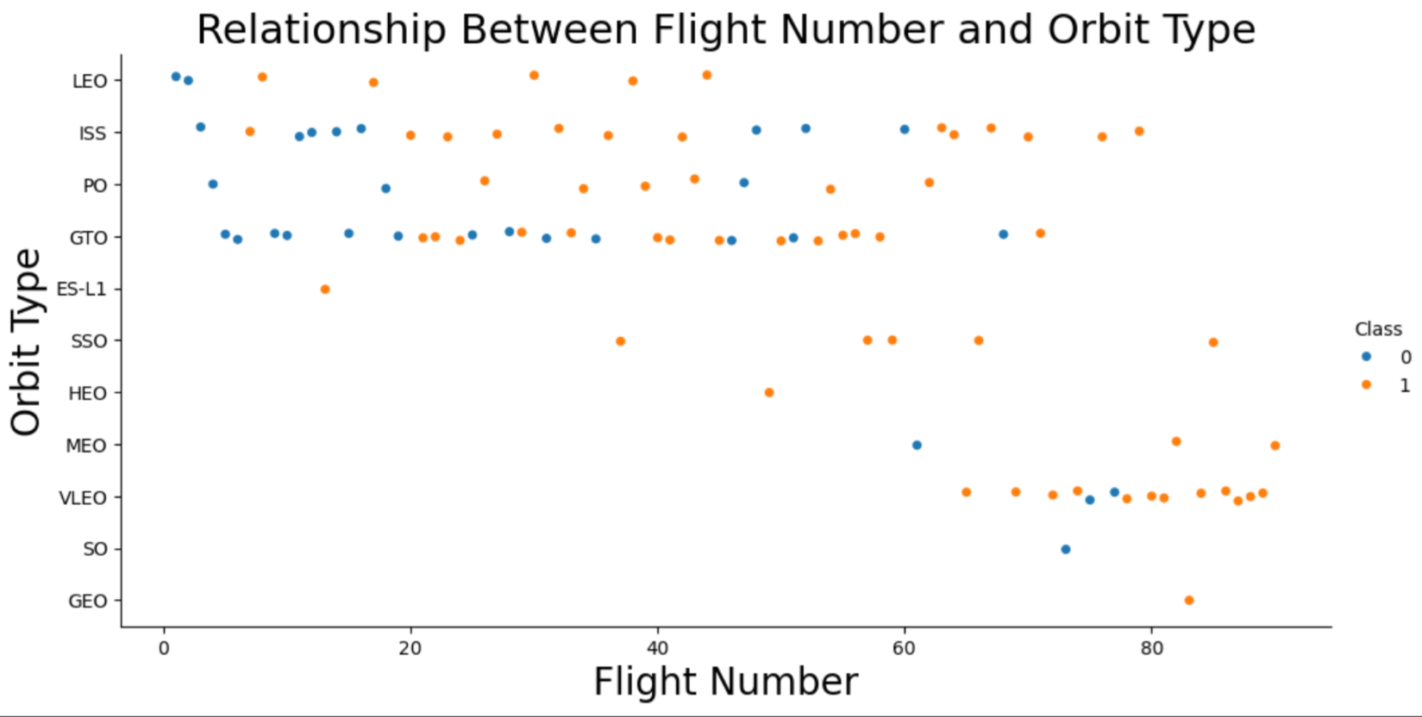
Flight Number vs. Orbit Type

Slide 42
Flight Number vs. Orbit Type
In the LEO orbit, success seems to be related to the number of flights. Conversely, in the GTO orbit, there appears to be no relationship between flight number and success.

Slide 43
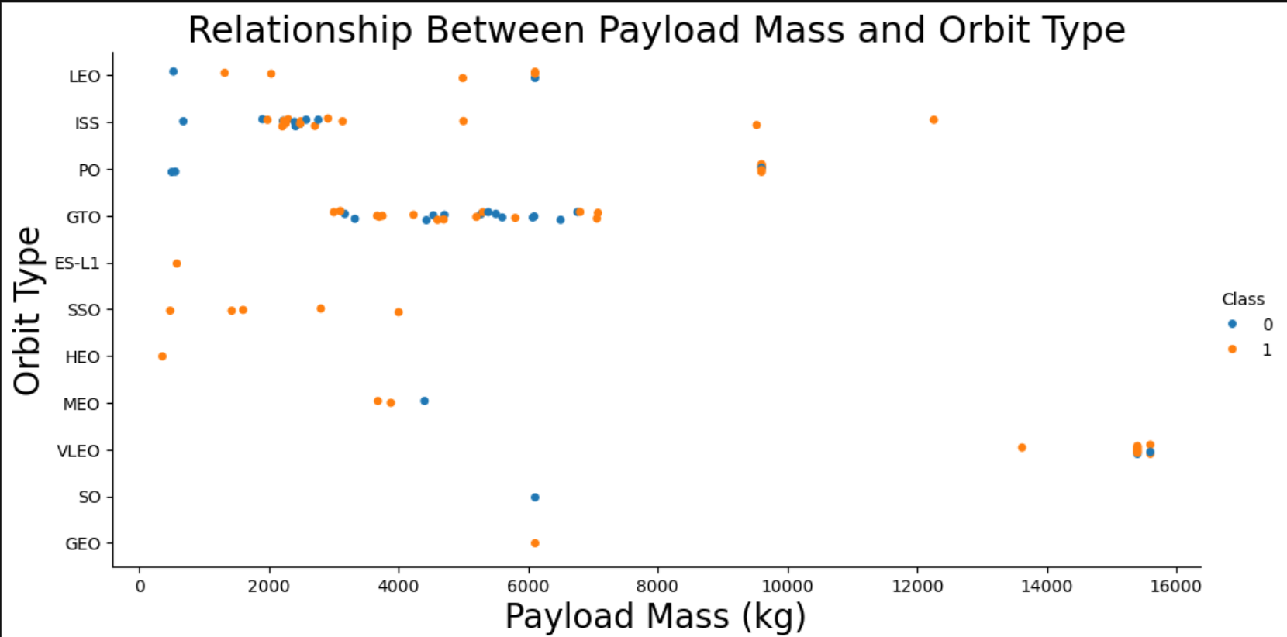
Payload vs. Orbit Type

Slide 44
Payload vs. Orbit Type
With heavy payloads the successful landing or positive landing rate are more for Polar,LEO and ISS.
However, for GTO, it's difficult to distinguish between successful and unsuccessful landings as both outcomes are present.

Slide 45
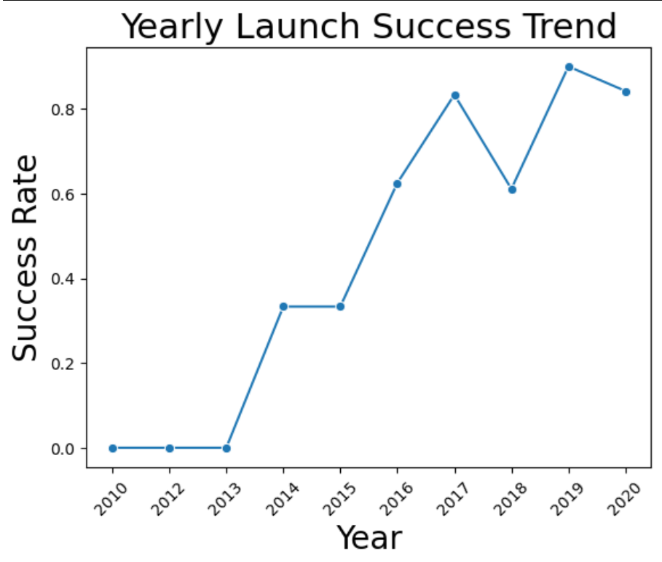
Launch Success Yearly Trend
Success rates steadily improved from 2013 to 2020.

Slide 46
All Launch Site Names
Launch Site
CCAFS LC-40
VAFB SLC-4E
CCAFS SLC-40
The query reveals the unique SpaceX launch sites present in the dataset: CCAFS LC-40, VAFB SLC-4E and CCAFS SLC-40.
Insight: SpaceX operates multiple launch sites, strategically distributed to support various mission requirements based on geography and payload specifications.

Slide 47
Launch Site Names Begin with 'CCA'
Date | Time (UTC) | Booster_Version | Launch_Site | Payload | PAYLOAD_MASS__KG_ | Orbit | Customer | Mission_Outcome | Landing_Outcome
2010-06-04 | 18:45:00 | Fa9 v1.0 B0003 | CCAFS LC-40 | Dragon Spacecraft Qualification Unit | 0 | LEO | SpaceX | Success | Failure (parachute)
2010-12-08 | 15:43:00 | F9 v1.0 B0004 | CCAFS LC-40 | Dragon demo flight C1, two CubeSats, barrel of Brouere cheese | 0 | LEO (ISS) | NASA (COTS) NRO | Success | Failure (parachute)
2012-05-22 | 7:44:00 | F9 v1.0 B0005 | CCAFS LC-40 | Dragon demo flight C2 | 525 | LEO (ISS) | NASA (COTS) | Success | No attempt
2012-10-08 | 0:35:00 | F9 v1.0 B0006 | CCAFS LC-40 | SpaceX CRS-1 | 500 | LEO (ISS) | NASA (CRS) | Success | No attempt
2013-03-01 | 15:10:00 | F9 v1.0 B0007 | CCAFS LC-40 | SpaceX CRS-2 | 677 | LEO (ISS) | NASA (CRS) | Success | No attempt

Slide 48
Launch Site Names Begin with 'CCA'
The data shows five SpaceX launches from 2010 to 2013 at CCAFS LC-40, with the following insights:
Mission Outcomes: All missions were successful despite challenges in landing technology.
Landing Outcomes: Early missions had either parachute failures or no landing attempts.
Payload Trends: Initial payloads were either light or test payloads, reflecting early development stages.
Orbit: Most missions targeted Low Earth Orbit (LEO) for research and resupply purposes.

Slide 49
Total Payload Mass
SUM(PAYLOAD_MASS__KG_)
45596
Query Result: The total payload mass carried by boosters for NASA (CRS) missions is 45,596 kg.
This query highlights SpaceX’s significant contribution to NASA’s Commercial Resupply Services (CRS), reflecting the boosters’ ability to handle substantial payloads for resupplying the International Space Station and conducting experiments in Low Earth Orbit (LEO).

Slide 50
Average Payload Mass by F9 v1.1
AVG(PAYLOAD_MASS__KG_)
2928.4
Query Result: The average payload mass carried by the F9 v1.1 booster version is 2,928.4 kg.
This result showcases the payload handling capacity of the Falcon 9 v1.1 booster. It reflects its reliability in medium payload missions, likely designed to optimize costs while maintaining efficiency for Low Earth Orbit (LEO) and other target orbits.

Slide 51
First Successful Ground Landing Date
MIN(Date)
2015-12-22
Query Result: The first successful ground landing occurred on 2015-12-22.
This marks a significant milestone for SpaceX as it demonstrates the company’s ability to successfully recover and reuse Falcon 9 boosters by achieving a precise landing on a ground pad, reducing launch costs and advancing spaceflight reusability.

Slide 52
Successful Drone Ship Landing with Payload between 4000 and 6000
Booster_Version
F9 FT B1022
F9 FT B1026
F9 FT B1021.2
F9 FT B1031.2
These results highlight the capability of Falcon 9 boosters to handle medium-heavy payloads while achieving successful drone ship landings, showcasing SpaceX's progress in reusability and precision landings under challenging conditions.

Slide 53
Total Number of Successful and Failure Mission Outcomes
Mission_Outcome | Total
Failure (in flight) | 1
Success | 99
Success (payload status unclear) | 1
The vast majority of SpaceX missions have been successful, demonstrating the company’s operational reliability. The single unclear payload status indicates an anomaly, while only one mission failure in flight highlights SpaceX’s commitment to mission success and safety improvements over time.

Slide 54
Boosters Carried Maximum Payload
Booster_Version
F9 B5 B1048.4
F9 B5 B1049.4
F9 B5 B1051.3
F9 B5 B1056.4
F9 B5 B1048.5
F9 B5 B1051.4
F9 B5 B1049.5
F9 B5 B1060.2
F9 B5 B1058.3
F9 B5 B1051.6
F9 B5 B1060.3
F9 B5 B1049.7
The Falcon 9 Block 5 (F9 B5) series boosters are capable of handling the heaviest payloads in SpaceX's missions. This highlights their superior engineering and efficiency in supporting high-mass missions, further advancing SpaceX's goal of reusability and cost reduction.

Slide 55
2015 Launch Records
Month_Name | Landing_Outcome | Booster_Version | Launch_Site
January | Failure (drone ship) | F9 v1.1 B1012 | CCAFS LC-40
April | Failure (drone ship) | F9 v1.1 B1015 | CCAFS LC-40
These results indicate two failed drone ship landings in 2015. Both occurred at CCAFS LC-40 using the Falcon 9 v1.1 booster version, highlighting early challenges in achieving successful drone ship landings before SpaceX perfected its landing technology.

Slide 56
Rank Landing Outcomes Between 2010-06-04 and 2017-03-20
Landing_Outcome | Count
No attempt | 10
Success (drone ship) | 5
Failure (drone ship) | 5
Success (ground pad) | 3
Controlled (ocean) | 3
Uncontrolled (ocean) | 2
Failure (parachute) | 2
Precluded (drone ship) | 1
The most frequent landing outcome was No attempt (10), followed by Success (drone ship) and Failure (drone ship), each with 5 occurrences. This highlights SpaceX's increasing attempts at drone ship landings, with continued challenges in achieving successful recoveries.

Slide 57

Section 3

Slide 58
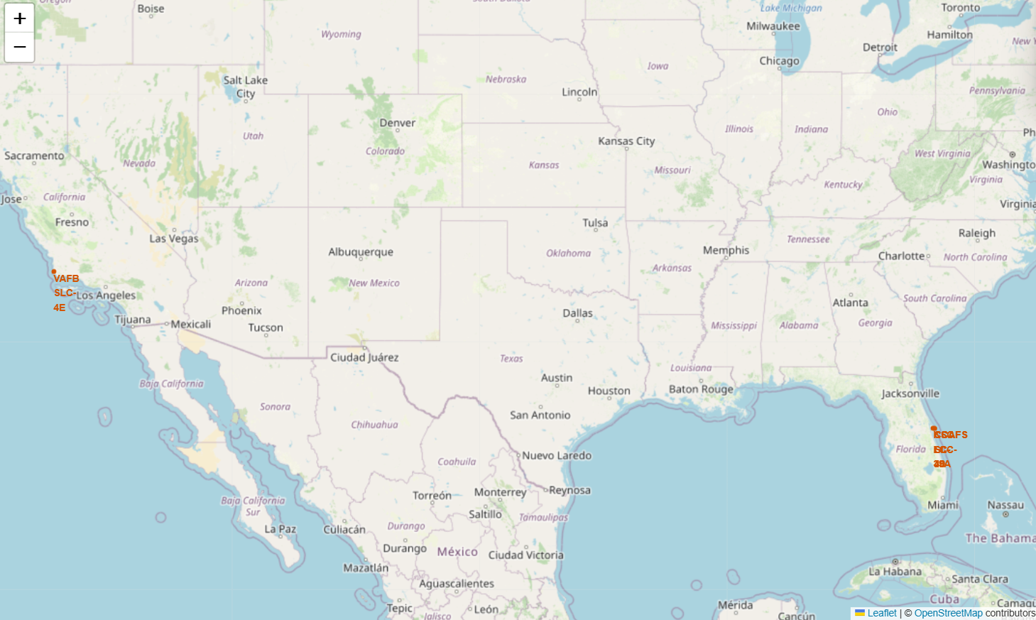
Global Map of SpaceX Launch Sites

Slide 59
Global Map of SpaceX Launch Sites
Screenshot Explanation:
The map shows the locations of all SpaceX launch sites globally.
Each site is represented by a marker, and the color coding or icons can indicate various landing outcomes or mission statuses.
Key Findings:
Launch sites are spread across multiple geographies, including the U.S. East and West coasts, reflecting SpaceX's global operational reach.
The map helps visualize proximity to other critical infrastructure (e.g., coastlines).

Slide 60
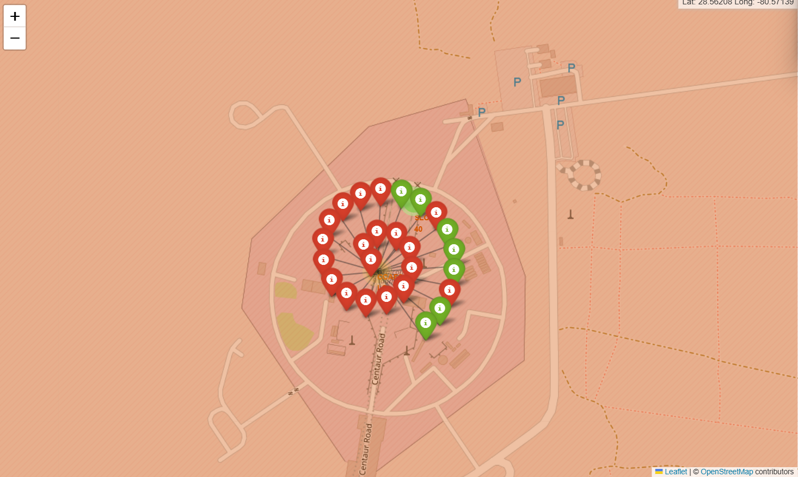
SpaceX Launch Outcomes by Location

Slide 61
SpaceX Launch Outcomes by Location
The map displays SpaceX launch sites with markers color-coded based on landing outcomes.
Color Legend: Green for success and red for failure
Key Findings:
Successful landings are concentrated at specific sites.
This visualization provides insights into the performance trends across launch sites globally.

Slide 62
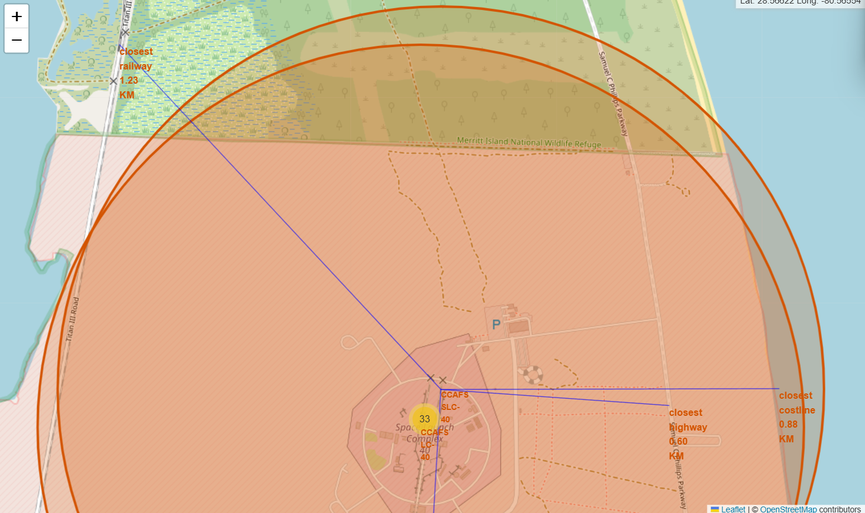
Proximity Analysis of SpaceX Launch Site

Slide 63
Proximity Analysis of SpaceX Launch Site
Screenshot Explanation:
The map shows the selected launch site along with proximity markers for railways, highways, and coastlines.
Distance Calculations: The distances from the launch site to these nearby infrastructure elements are displayed for context.
Key Findings:
The map illustrates how geographical factors like nearby transportation routes and coastlines influence launch site accessibility and safety.
This proximity data helps assess potential risks and logistical support for launches.

Slide 64

Section 4

Slide 65
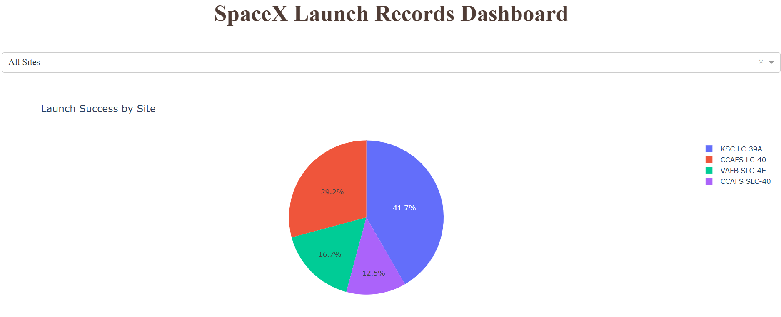
SpaceX Launch Success Distribution by Site (Pie Chart)

Slide 66
SpaceX Launch Success Distribution by Site (Pie Chart)
Screenshot Explanation:
The pie chart shows the success distribution of launches across all SpaceX sites.
Key Elements:
The majority of launches are successful, illustrating SpaceX’s operational efficiency across different locations.
This chart offers a clear visual representation of SpaceX's high success rate, further reinforcing their reputation for reliable rocket launches.

Slide 67
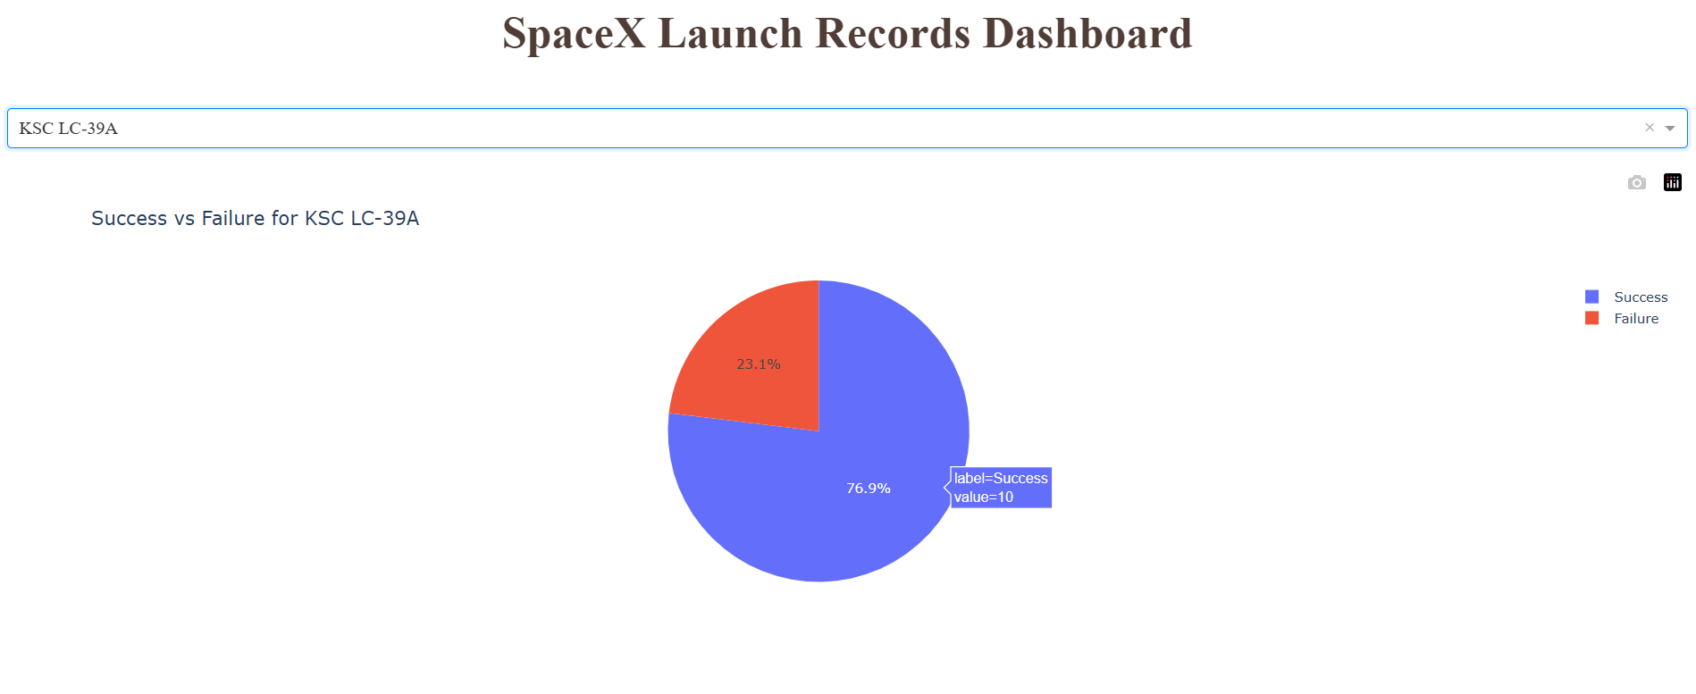
KSC LC-39A Launch Success Ratio​

Slide 68
KSC LC-39A Launch Success Ratio​
The pie chart showcases the launch success ratio specifically for the KSC LC-39A launch site, highlighting the percentage of successful launches compared to failures.​
Key Findings:​
KSC LC-39A has a very high success rate, indicating the site's effectiveness in supporting missions.​
This chart emphasizes KSC LC-39A's pivotal role in SpaceX's operations and its critical contribution to the overall success of SpaceX's launch programs.​

Slide 69
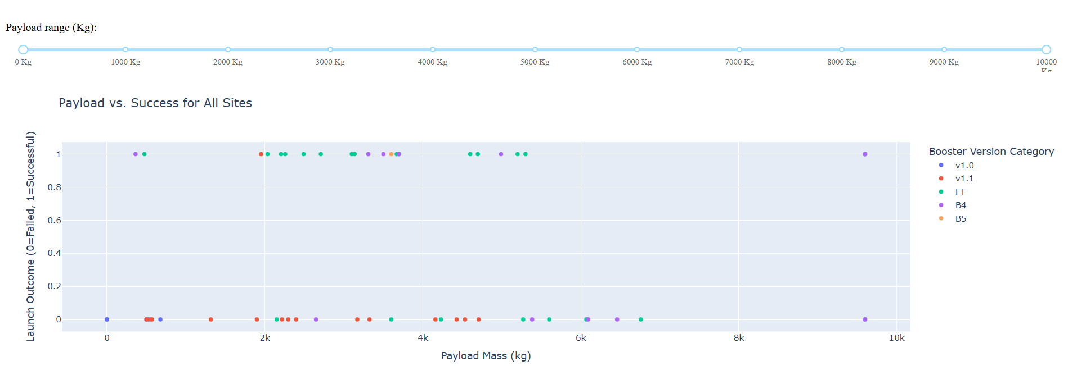
Payload vs. Launch Outcome for All Sites

Slide 70
Payload vs. Launch Outcome for All Sites
The scatter plot visualizes the relationship between payload mass and launch outcomes across all SpaceX launch sites, with varying payload ranges selected using the range slider.
Key Findings:
F9 v1.1 boosters tend to have a higher failure rate.
FT boosters show high success rates for payloads between 2000-6000 kg.
B4 boosters perform best with payloads between 3000-5000 kg, showing consistent success.
This highlights the correlation between booster versions, payload sizes, and success rates.

Slide 71

Section 5

Slide 72
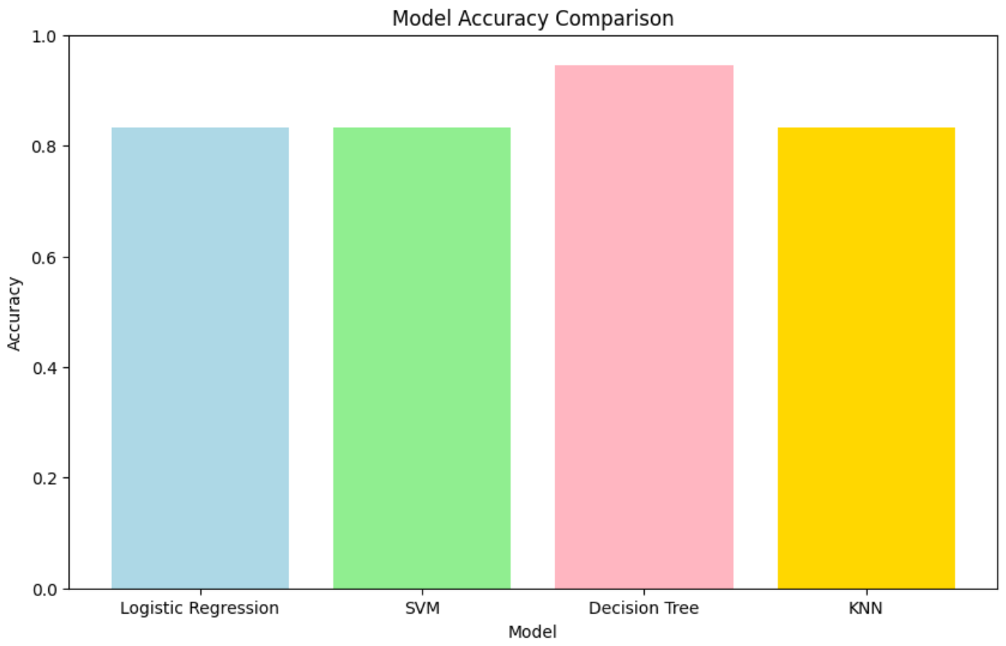
Classification Accuracy
Best Model: Decision Tree Classifier with accuracy 0.9444 on the test data.
(see appendix A for features)

Slide 73

Confusion Matrix
The confusion matrix shows the count of actual vs. predicted values for each class: "Did not land" (0) and "Landed" (1).
True Positives (TP): Correct predictions of "Landed".
True Negatives (TN): Correct predictions of "Did not land".
False Positives (FP): Misclassified "Did not land" as "Landed".
False Negatives (FN): Misclassified "Landed" as "Did not land".

Slide 74
Conclusions
Point 1
Point 2
Point 3
Point 4
…

Slide 75
Appendix
A
Features for tree classifier :
{'criterion': 'entropy', 'max_depth': 8,'max_features': 'sqrt','min_samples_leaf': 2, 'min_samples_split': 2, 'splitter': 'random'}

Slide 76


